Slide 1
LAB – 3 Operating Systems

Slide 2
GroupID - 6
Abhijeet Sonkar
Aditya Aggarwal
Ambika Singh
Avneesh Kumar
Divy Agrawal
IIB2019009
IIT2019210
IIB2019017
IIB2019010
IIT2019211

Slide 3

Questions Assigned
6
Implement blocking semaphore using the pause() and kill() system calls (to block and unblock a process, as demonstrated in my example programs / videos). Now, use your solution to ensure mutually exclusive access to a shared variable by two cooperating processes. Demonstrate the correctness of your
solution by applying it to solve the race condition problem that I have created in my sample programs “producer3.c” and “consumer3.c”.

Slide 4
Table of Contents
1
Basic Concepts
2
Code Explanation
3
Demonstration

Slide 5
Basic Concepts
1

Slide 6
What is Semaphores?
Proposed by Dijkstra in 1965
Technique to manage concurrent processes by using integer value, called semaphore.
Used to solve critical section problem.
Achieve process synchronization in multi process communication
Binary Semaphore
Counting Semaphore
Also called mutex lock
Can have only two values 0 and 1
Implemented to solve critical section problem in multiple processes.
Mutual Exclusion is possible.
Its value can lie in any unrestricted domain
No mutual exclusion
More than one process can enter critical section.

Slide 7
More on Binary Semaphore
Used to control access to single resource.
Used to enforce mutual exclusion for a critical section.
Semaphore is created with an initial value of 1 (no task is executing critical section)
While entering critical section, a task must try to acquire semaphore to prevent other task from entering the critical section.
While exiting from critical section, the task must release the semaphore to allow another task to execute the critical section.
How it is different from blocking binary semaphore?
In blocking binary semaphore, when process P1 is executing the critical section, and process P2 tries to acquire semaphore, then P2 will not be able to acquire semaphore and P2 will be stored in a queue. P2 goes to blocked state and does not wakes up until a signal is received.
P1 on exiting from the critical section, releases the semaphore and wakes up one of the process from the queue.
It guarantees mutually exclusive access to critical section.

Slide 8
Pseudo code for blocking binary semaphore
int sem = 1; // initial value of shared variable
Down(sem){
//this comparison in if condition is non-atomic
while(sem<=0){
Store this process onto Queue
pause()
}
//this is also non-atomic operation
sem--;
}
Up(sem){
sem++; //this is also non-atomic operation
Pop one process from the queue and wakeup it
}

Slide 9
What is race condition?
A race condition occurs when two or more threads or cooperating processes can access shared data and they try to change it at the same time. Because the thread/process scheduling algorithm can swap between threads/processes at any time, we don't know the order in which the threads or the cooperating processes will attempt to access the shared data. And this may lead to different results every time pertaining to the sequence of execution of the cooperating processes or threads. .
It can be avoided by ensuring mutual exclusion of processes or threads accessing the shared variable at the same time. Also use of many synchronization algorithms or locks can prevent race conditions.
What is atomic operation?
Atomic implies indivisibility and irreducibility, so Atomic operation are those operations that finish their tasks as a whole i.e. no other interruption is allowed before its completion i.e., an atomic operation must be either performed entirely or not performed at all.
it is an operation that will always be executed without any other process being able to read or change state that is read or changed during the operation. It is effectively executed as a single step.

Slide 10
Code Explanation
2
Lets brielfy discuss the code

Slide 11
typedef struct
{
int x;
int f;
int prid;
int cnid;
} mydata;
int *s;
int id;
void my_handler() {}
int *s;
shared variable which will be used to implement semaphore and implement mutual exclusion of the two cooperating processes.
int id;
it is a global variable declared to store the id of the shared memory associated with the key for shared variable s.

Slide 12
void down()
{
while (!__sync_val_compare_and_swap(s, 1, 0))
{
pause();
}
}
void down()
function is invoked by the process trying to enter the critical section to acquire the semaphore so that it can gain access to the critical section.
while (!__sync_val_compare_and_swap(s, 1, 0))
non-busy waiting
if no process has yet acquired the semaphore and the critical section then invoking process can acquire it by decrementing its value from 1 to 0 and enter critical section.
if critical section is already acquired, then invoking process gets blocked and waits until next signal.
decrementing semaphore is not atomic, So we swap the previous value with 0 using atomic swap function __sync_val_compare_and_swap(s, 1, 0).
function return previously stored value, which is used to check if any process has acquired critical section or not.
pause();
Causes calling process/thread to sleep until a signal is delivered.
Signaling leads to the process getting unblocked and starting its execution again.

Slide 13
void up()
{
__sync_val_compare_and_swap(s, 0, 1);
kill(data->cnid, SIGUSR1);
}
void up()
function is invoked by the process exiting the critical section to release previously acquired semaphore, so that other process can execute critical section
__sync_val_compare_and_swap(s, 0, 1);
To release the access of critical section, we need to increment the semaphore from 0 to 1
But incrementing is not an atomic operation, so we will use above function to swap semaphore value atomically.
kill(data->cnid, SIGUSR1);
Send signal to process whose process_id (data->cnid) has been specified.

Slide 14
void create_shared_memory()
{
key_t keys = ftok("buffer.txt", 18);
if (keys < 0)
{
perror("error0:");
exit(1);
}
id = shmget(keys, sizeof(int), IPC_CREAT | 0666);
if (id < 0)
{
perror("error1:");
exit(1);
}
s = (int *)shmat(id, NULL, 0);
if (s == (void *)-1)
{
perror("error2:");
exit(1);
}
(*s) = 1;
}
ftok("buffer.txt", 18);
Used to create a unique key associated with shared memory.
if (keys < 0){...}
Checks if the keys was generated successfully or not.
If not print error and exit from program.
id = shmget(keys, sizeof(int), IPC_CREAT | 0666);
returns the identifier of the shared memory segment associated with the value of the argument key. IPC_CREAT to create a new segment.
0666 gives all users on the system to access the shared memory and access to read and write.
if (id < 0){...}
Checks if the id was generated successfully or not.
If not print error and exit from program.
s = (int *)shmat(id, NULL, 0);
accepts a shared memory ID, id, and attaches the indicated shared memory to the program's address space. The returned value is a pointer of type (void *) to the attached shared memory.
if (s == (void *)-1){...}
Used to check if shared memory segment was attached successfully or not to the the address space of calling process. Return -1 in case of error, prints error and terminates program.
(*s) = 1;
Initializes the value of semaphore to 1.

Slide 15
Demonstration
3
Lets have a look at the screenshots

Slide 16
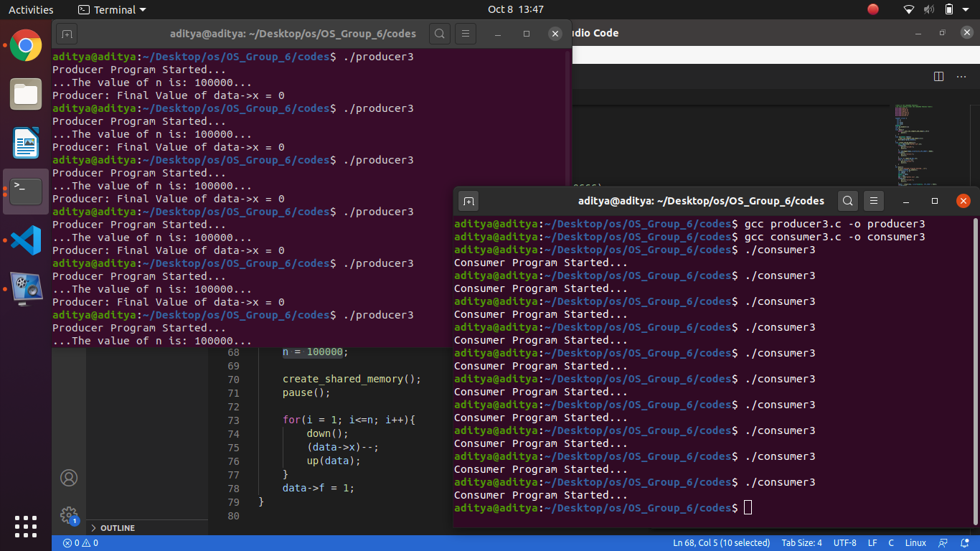

Slide 17


Slide 18
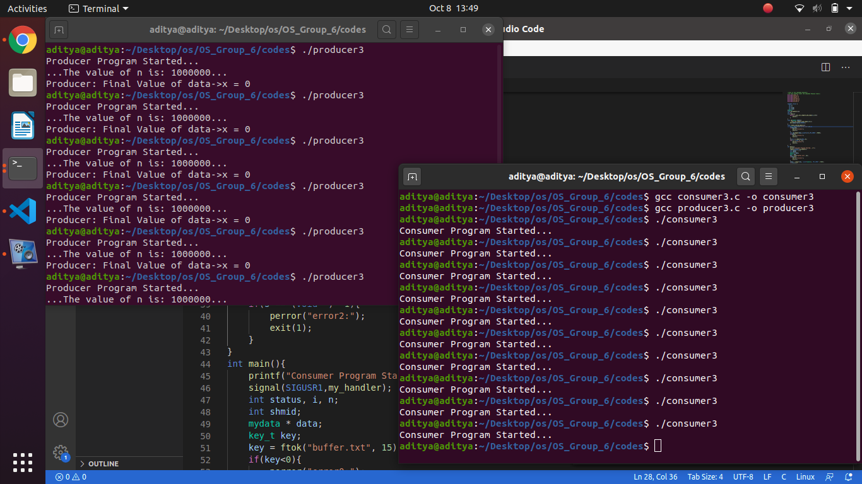

Slide 19
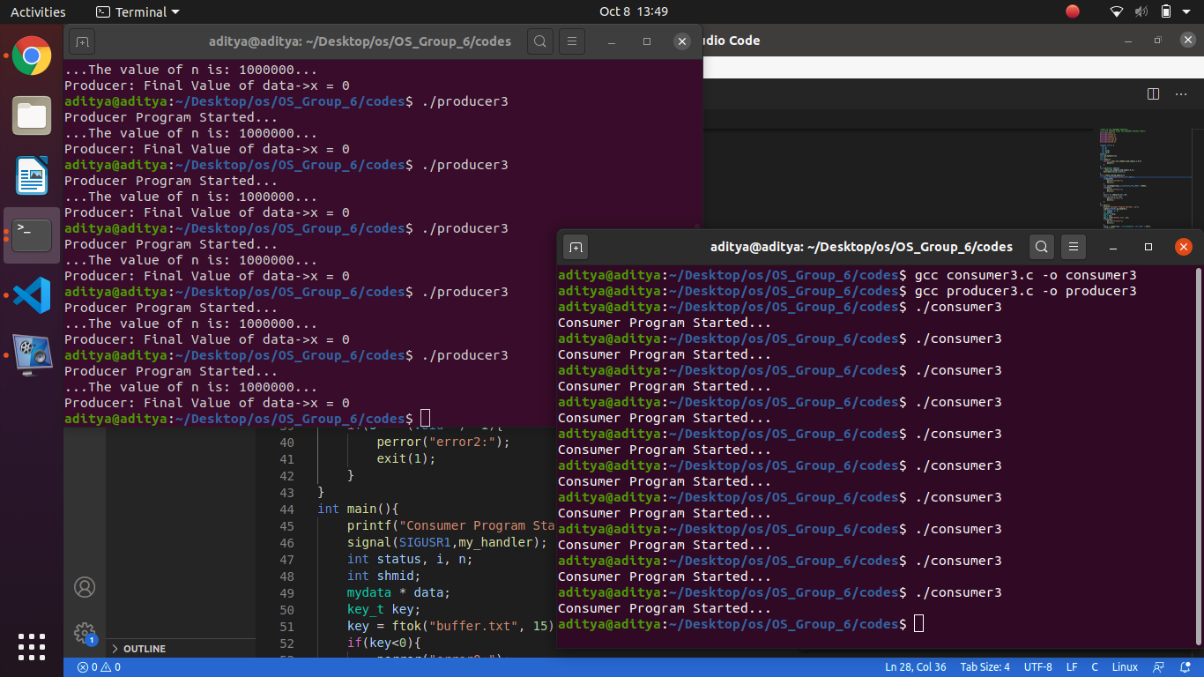

Slide 20
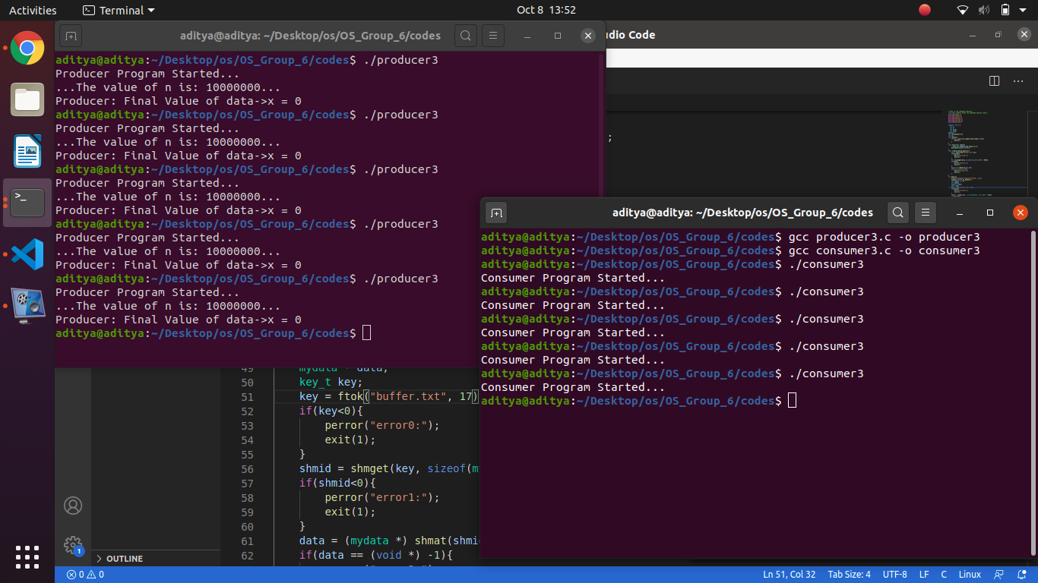

Slide 21
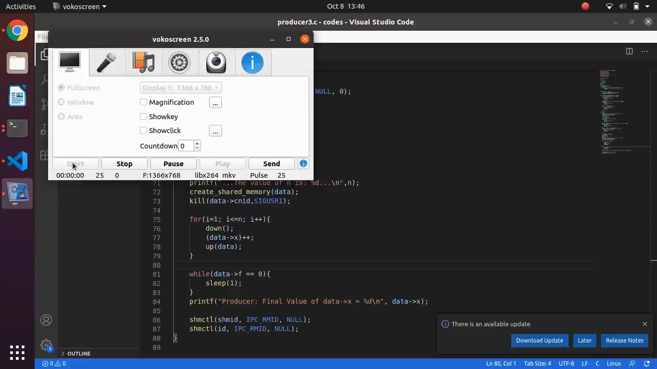

Slide 22
THANK YOU

